Slide 1

CUSTOMER MOVEMENT ANALYSIS
Srisuda WONGVORARUJ

Slide 2
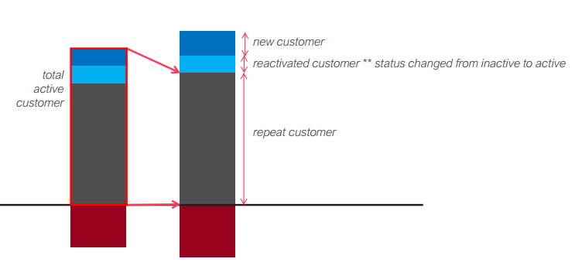
Description
New Customer : Customer who never appeared in the previous months.
Reactivated Customer : Customers who bought then disappear. The previous month did not appear but come back and buy in this month
Repeat Customer : Customers who bought last month and still buy in this month.
Churn Customer : Customers who bought last month but this month did not appear.

Slide 3
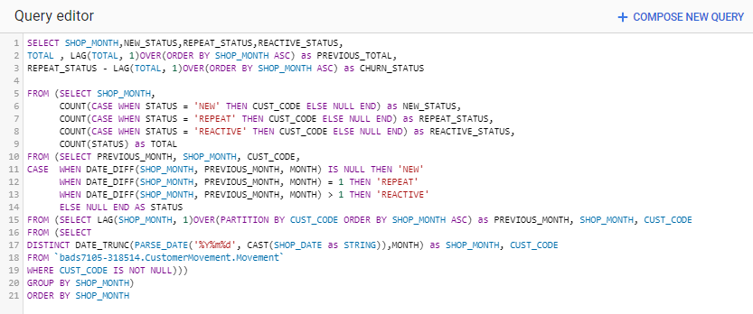
SQL CODE

Slide 4
